Slide 1
Performance Analysis of Renderscript
- Prakalp Srivastava, Cuong Manh Pham, and Abdul Dakkak

Slide 2
Programmability of Heterogeneous Systems
Incompatible memory systems
6 different hardware ISAs
Modem
CPU
CPU
GPU
Vector
Vector
A/V Hardware Accelerators
GPS
L1 Cache
L1 Cache
DSP
DSP
DSP
Multi-media
L2 Cache
Interconnect
Main Memory
Modern smartphone SoC
7 different parallelism models
Need easier programmability!

Slide 3
Today’s Solutions
OpenMP
CUDA
OpenCL
RenderScript
Target at computationally intensive and data-parallel tasks
Focus on: Portability and Development Efficiency
Scheduling at runtime: parallelize work across all available computing resources, such as CPUs, GPUs, and DSPs
Mobile centrics

Slide 4
Mobile vs. Desktop
Requirements
Power is as important as performance on mobile
Ease of development and deployment
Users
Might use compute intensive applications without knowing it
Distribution
Cannot depend on non-native libraries
No concept of package dependencies

Slide 5







Desktop Heterogeneity
Practically every desktop is x86 machine with either an Intel, ATI, or NVIDIA GPU
Homogenous hardware
Heterogeneous software
Thousands of programming languages

Slide 6



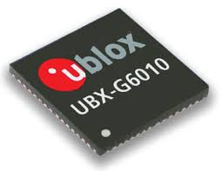

Mobile Heterogeneity
Practically every mobile is running either IOS or Android
Heterogeneous hardware
Homogenous software
Few programming languages

Slide 7
RenderScript’s Approach

Slide 8
RenderScript Offline Compilation
LLVM Codegen
foo.bc
Bundled with final application file
ScriptC_foo.java
foo.rs
Offline Compiler
Compiled with rest of application *.java files
...
ScriptField_s.java
Java Wrapper Files

Slide 9



RenderScript Online JIT Compiler Flow
foo.bc
Online JIT Compiler
ScriptC_foo.java
Accelerators (GPUs, DSPs)
...
ScriptField_s.java
Java VM JIT
...
ARM Cores
App Java Source Files
Final Application File

Slide 10
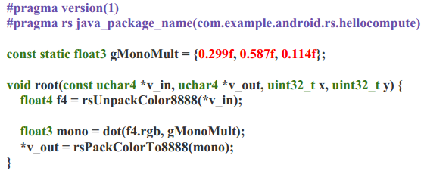
RenderScript Example

Slide 11
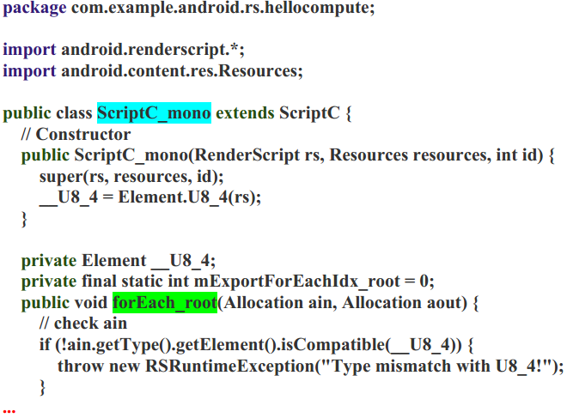
RenderScript Example contd.

Slide 12
RenderScript Claims
Offline Compiler
Embeds information in bitcode
Online JIT Compiler
Performs target-specific optimizations and code generation
Using information embedded in bitcode
But
HW-specific features are deliberately not exposed for portability
We need comprehensive performance analysis to test their claim

Slide 13
Methodology
Performance analysis of compute kernels
Measure the compute time against both the optimized and unoptimized OpenCL implementations
Measure the compute time against the threaded C version using Android’s NDK

Slide 14
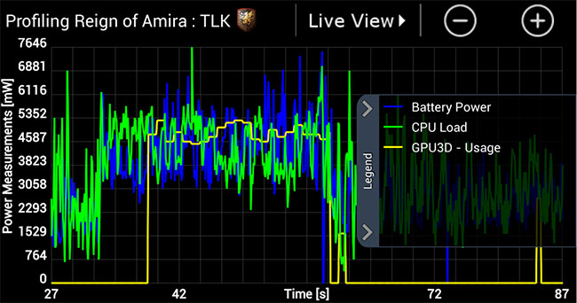
Methodology
Power analysis of benchmarks
User Androids performance metrics to measure power usage
Compare the power draw against OpenCL and the native multithreaded implementations

Slide 15
Methodology
Programmability (objectively measured)
How does RenderScript compare with OpenCL in terms of programmability?
Does hiding architectural details, while adding runtime and compiler optimizations, result in performance close to hand tuned kernels?
Are there any missed optimizations from the RenderScript compiler and/or runtime?
Are there any RenderScript compiler optimizations that would benefit OpenCL or CUDA programmers.

Slide 16
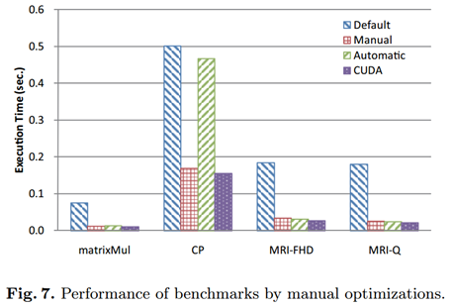
Related Work: OpenCL
OpenCL vs. CUDA: extensively studied. Consensuses:
CUDA is generally better on NVIDIA GPUs
OpenCL has sufficient interface to provide arch. details
Peak performance comparable with CUDA
Performance portability
Compilers matter
Tested on NVIDIA
Tesla C1060
Source image: K. Komatsu, K. Sato, Y. Arai, K. Koyama, H. Takizawa, and H. Kobayashi. Evaluating performance and portability of opencl programs. In The fifth international workshop on automatic performance tuning, 2010.
Notes:
NVIDIA
Tesla C1060 (Tesla)

Slide 17
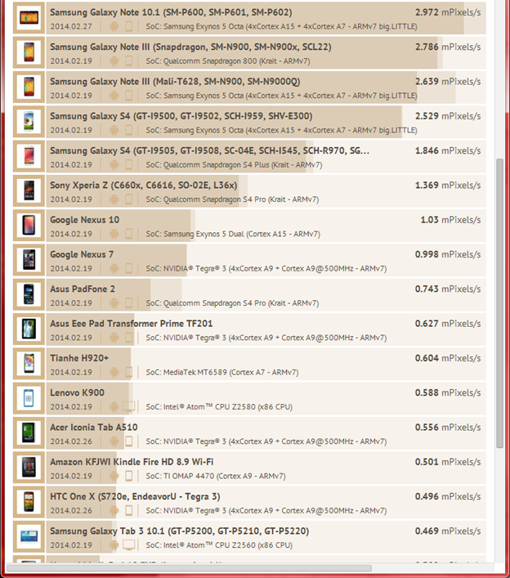
Related Work: Benchmarking RS
CompuBench Mobile RenderScript Benchmark
No source code, offered as an app on Google Play
Cannot port to other languages
Not suitable to conduct deep analysis
O2Render [1]: OpenCL to RenderScript translator
Reuse legacy OpenCL code
Achieved comparable performance for some simple applications
Not available to public :(
Source: https://compubench.com/result.jsp
[1] C. Yang et al. “O2render: An OpenCL-to-RenderScript translator for porting across various GPUs or CPUs,” In Embedded Systems for Real-time Multimedia (ESTIMedia), 2012 IEEE 10th Symposium on, pages 67–74. IEEE, 2012.
Notes:
O2Render is not offered to public

Slide 18
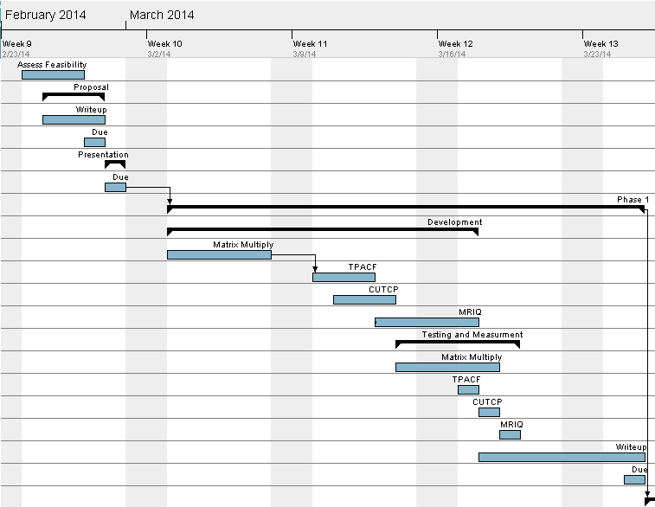
Schedule (Phase 0 & 1)

Slide 19
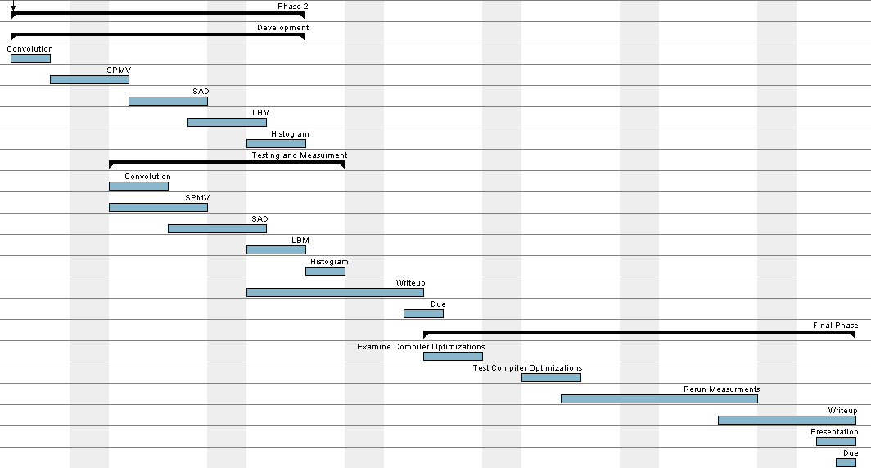
Schedule (Phase 2 & 3)

Slide 20
Backup

Slide 21
Related Work: OpenCL (cont’)
OpenCL vs. OpenMP for multi-core CPUs [1]
Picked three OpenCL’s worse performing apps
After tuning the apps -> OpenCL outperformed or similar to OpenMP in 80% test cases
OpenCL performance portability [2, 3]
[2] <12% performance loss across platforms (Intel Xeon Phi, NVIDIA K20C and AMD 7970 GPU)
[3] OpenCL is more optimized for GPUs than for CPUs
[1] J. Shen, J. Fang, H. Sips, and A. L. Varbanescu. Performance gaps between openmp and opencl for multi-core cpus. In Parallel Processing Workshops (ICPPW), 2012 41st International Conference on, pages 116–125. IEEE, 2012.
[2] R. Dolbeau, F. Bodin, and G. C. de Verdiere. One opencl to rule them all? In Multi-/Many-core Computing Systems (MuCoCoS), 2013 IEEE 6th International Workshop on, pages 1–6. IEEE, 2013.
[3] K. Komatsu, K. Sato, Y. Arai, K. Koyama, H. Takizawa, and H. Kobayashi. Evaluating performance and portability of opencl programs. In The fifth international workshop on automatic performance tuning, 2010.

